Slide 1
IoT Co-Based Activity
Case Study on Healthcare
Presented by :- Anushka Deshpande (6ETC08)
Ashlesha Thakare (6ETC13)
Monali Bhelkar (6ETC31)
Pranita Bire (6ETC35)
Triveni Dhavandkar (6ETC68)
Presented to :- Mr Amit Tripathi Sir

Slide 2
Healthcare Case Studies
Transforming Lives Through Innovation
Three real-world cases — cardiac care, diabetes management, and cervical cancer treatment — revealing how data, compassion, and clinical excellence converge to save lives.

Slide 3
CHAPTER 1
The Human Element
A Cardiac Patient's Journey
Behind every chart and lab result is a person. This case study follows one patient's path from cardiac crisis to recovery — and the clinical decisions that made it possible.

Slide 4

CARDIAC CASE STUDY
A Complex Cardiac Case: Management and Interventions
What This Case Covers
This case illustrates how structured documentation and timely intervention directly influence survival and recovery outcomes in acute cardiac settings.
Patient history, presenting symptoms, and physical exam findings
Diagnostic procedures, imaging results, and critical lab data
Step-by-step treatment progression and complications managed
Critical care interventions and multidisciplinary team decisions

Slide 5
From Crisis to Care: A Patient's Recovery
🚨 Admission
🔬 Diagnosis
Acute presentation with hemodynamic instability requiring immediate stabilization
Imaging and labs confirm complex cardiac pathology requiring intervention
💊 Intervention
✅ Recovery
Targeted procedures and critical care protocols restore cardiac function
Stable rhythm achieved; patient transitions to rehabilitation and discharge planning

Slide 6
CHAPTER 2
Programmatic Success
Combating Diabetes at Scale
Diabetes is a global epidemic — but structured, data-driven programs are proving that population-level outcomes can improve dramatically when care is coordinated, measured, and patient-centered.

Slide 7
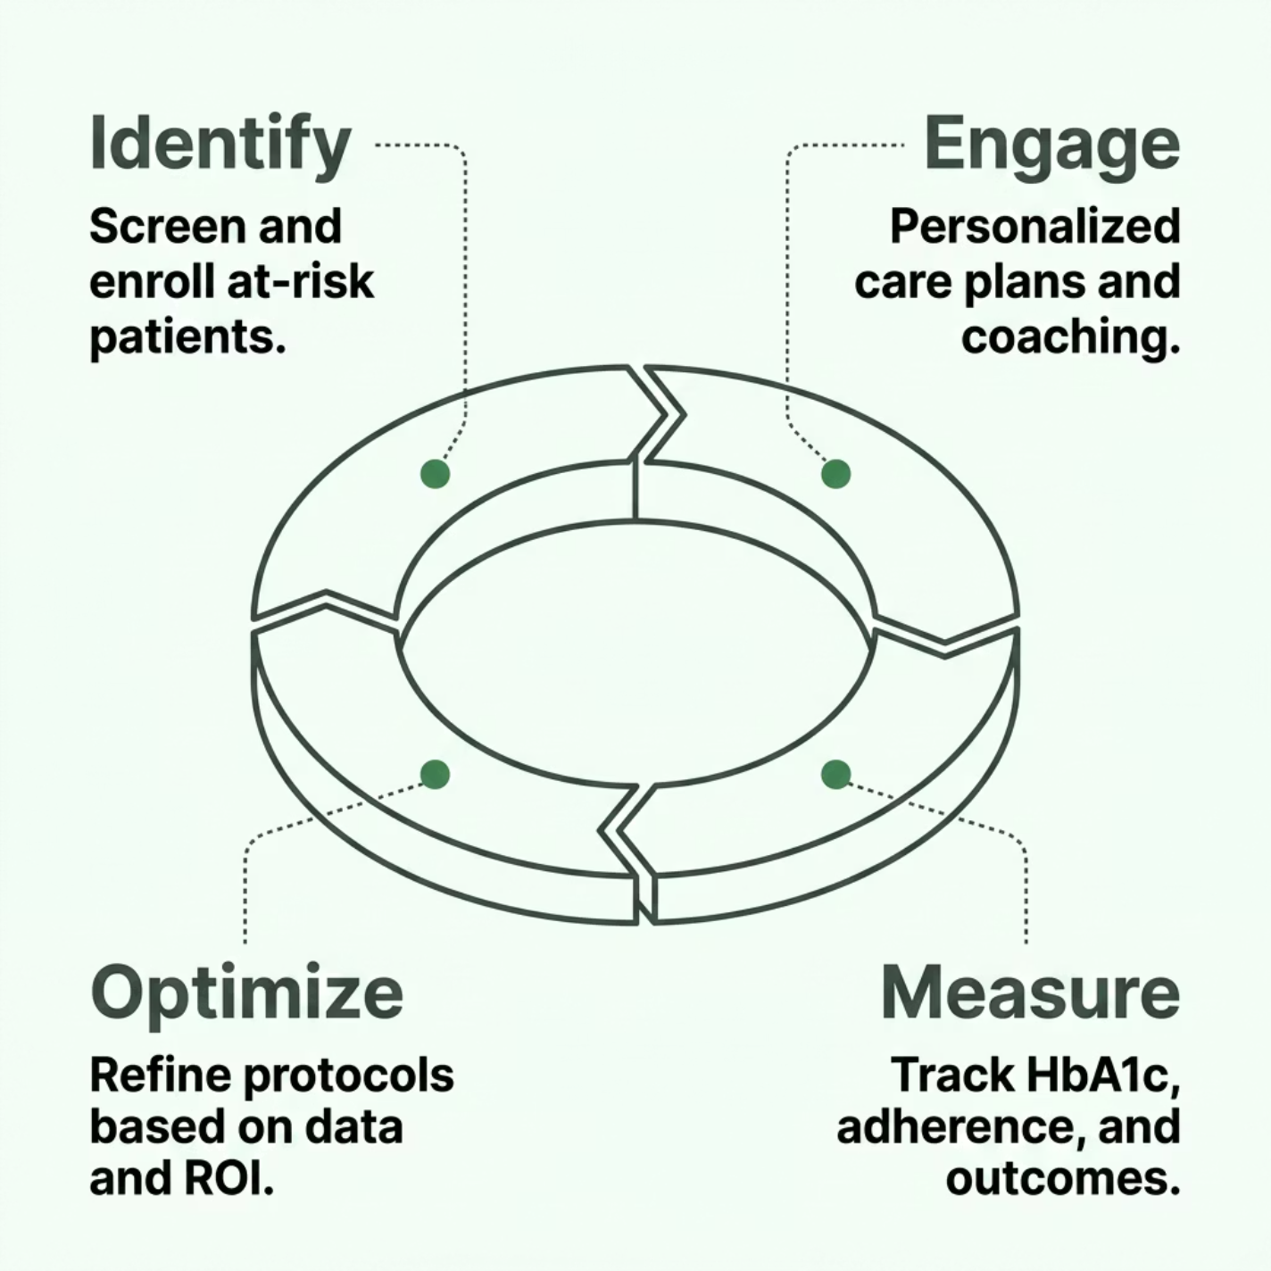


DIABETES PROGRAM
Enhancing Healthcare: The RIPA/Excellus Diabetes Program
Program Highlights
PFP (Pay for Performance) model driving measurable HbA1c reductions
ROI analysis demonstrating cost savings alongside improved outcomes
Implementation strategies transferable to other healthcare systems
Lessons learned from real-world deployment at scale
The program demonstrated that aligning financial incentives with quality metrics produces sustainable, scalable improvements in chronic disease management.

Slide 8
Data-Driven Success, Human Impact
↓1.2%
3:1
78%
Average HbA1c Reduction
Return on Investment
Patient Satisfaction
Observed across program participants within 12 months of enrollment
For every dollar invested in the program, three dollars saved in avoided complications
Reported higher engagement and confidence in managing their condition

Slide 9
CHAPTER 3
Specialized Care
Cervical Cancer Management
Cervical cancer remains a leading cause of mortality in underserved communities. This case study examines how clinical rigor, nursing excellence, and community awareness converge to change outcomes — one patient at a time.

Slide 10
CLINICAL CASE STUDY
Comprehensive Clinical Case: Cervical Cancer
Key Areas of Analysis
Diagnostic workup: staging, imaging, and histopathology
Treatment protocols: surgery, chemotherapy, and radiation
Nursing interventions and patient education strategies
Community impact and implications for public health policy
Case Setting
Clinical case conducted at Hospital Eugenio Espejo, examining real-world diagnosis, treatment pathways, and nursing interventions for cervical cancer.

Slide 11

The Future of Healthcare
Innovation and Patient-Centricity
Targeted Interventions Work
From cardiac crises to chronic disease, precision care improves survival and quality of life
Data Is the Compass
Measuring outcomes, ROI, and patient satisfaction drives continuous improvement
Human-Centered Care Is Non-Negotiable
Technology and data must always serve the patient — not the other way around
Call to Action: Embrace data-driven strategies, invest in comprehensive programs, and never lose sight of the human story behind every case.

Slide 12
THANK-YOU

